Slide 1
INSTALL INFORMATION

Slide 3
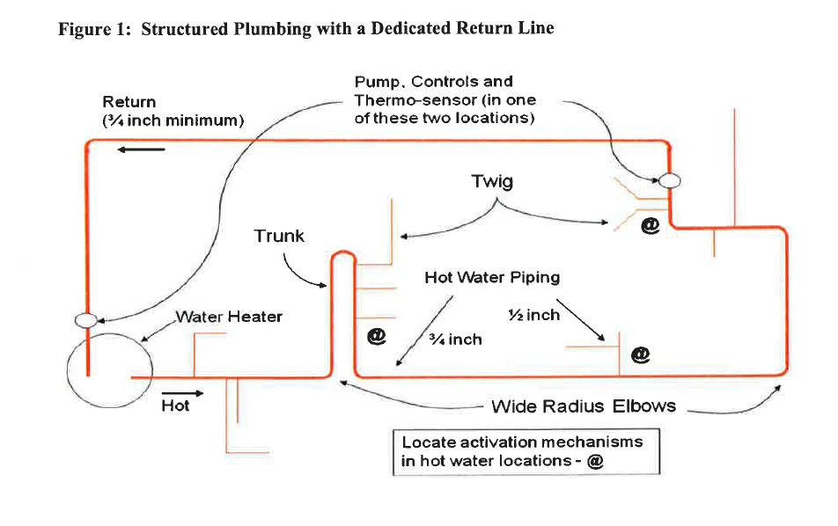

Slide 5
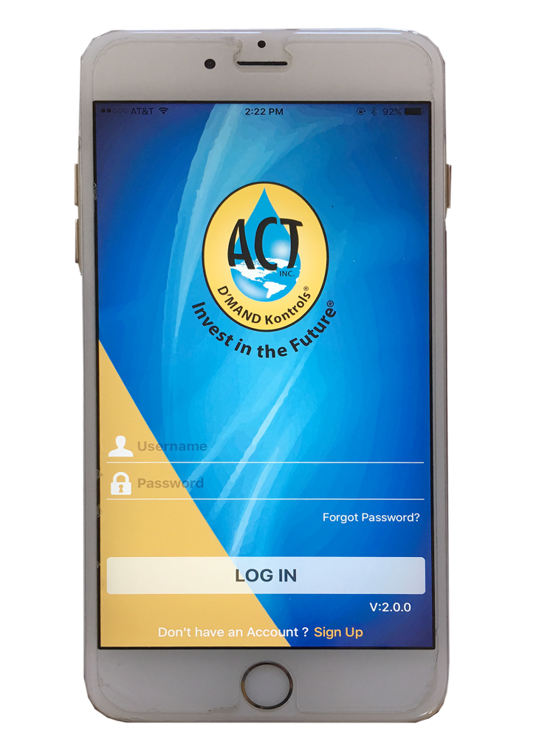
New Bluetooth Capability
Available for both i0S and Android.
Simple & convenient activation.

Slide 6
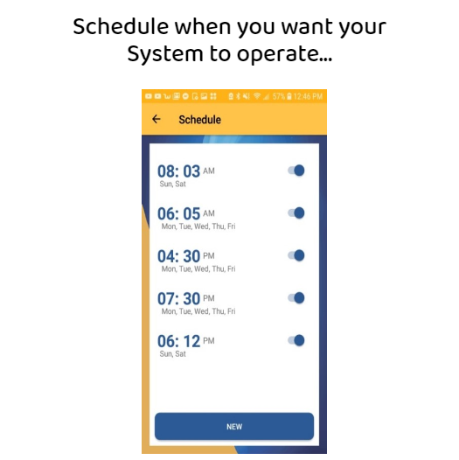

Slide 7
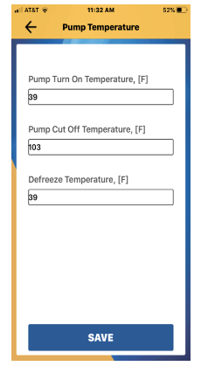

Slide 8
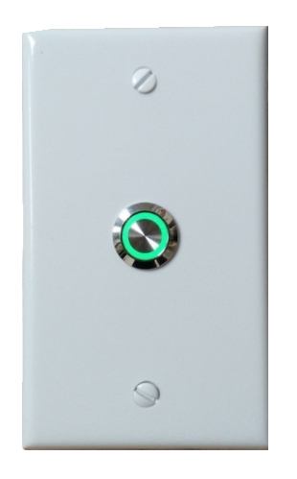
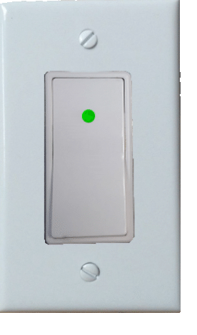
PATENTED LED D’MAND BUTTONS

Slide 9
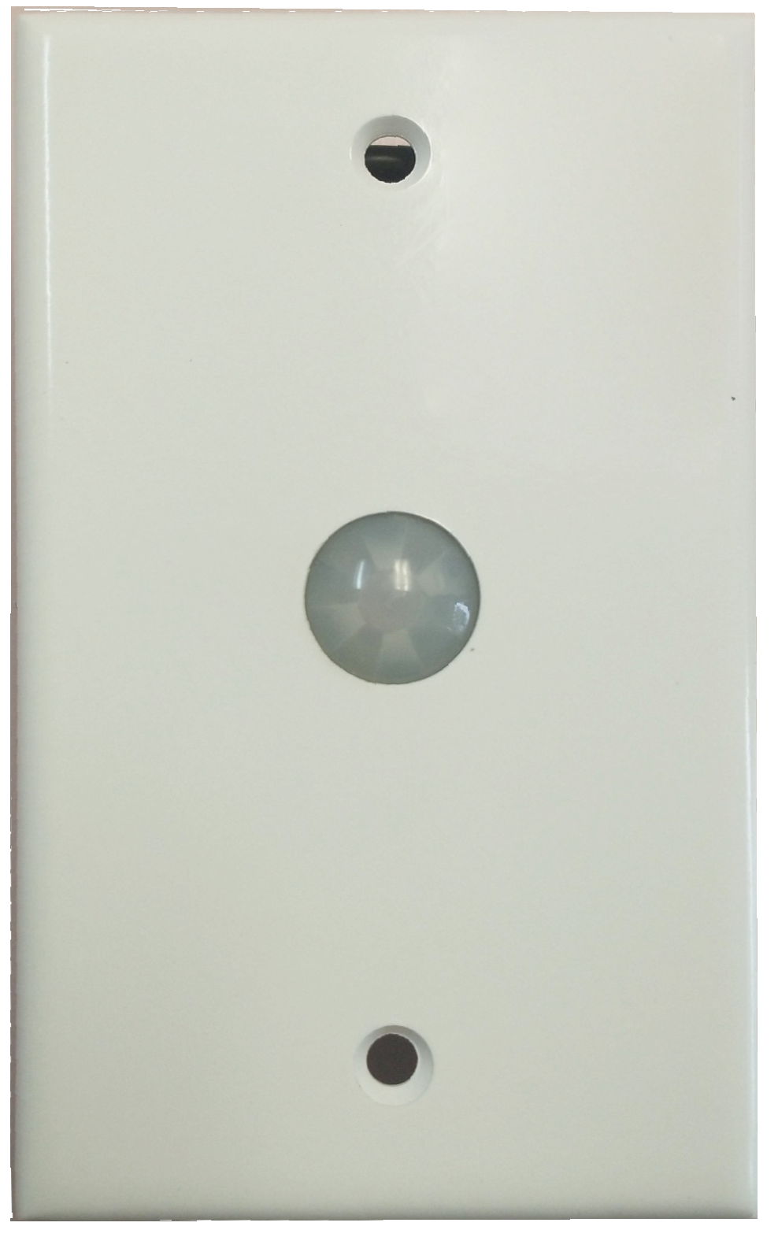
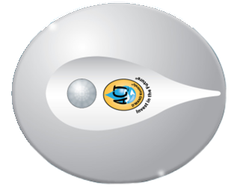
CUSTOM DESIGN D’MAND MOTION SENSORS

Slide 10
MADE IN AMERICA
U.S. DEVELOPED TECHNOLOGY INVENTED IN AMERICA, MANUFACTURED IN AMERICA SINCE 1992

